Slide 1
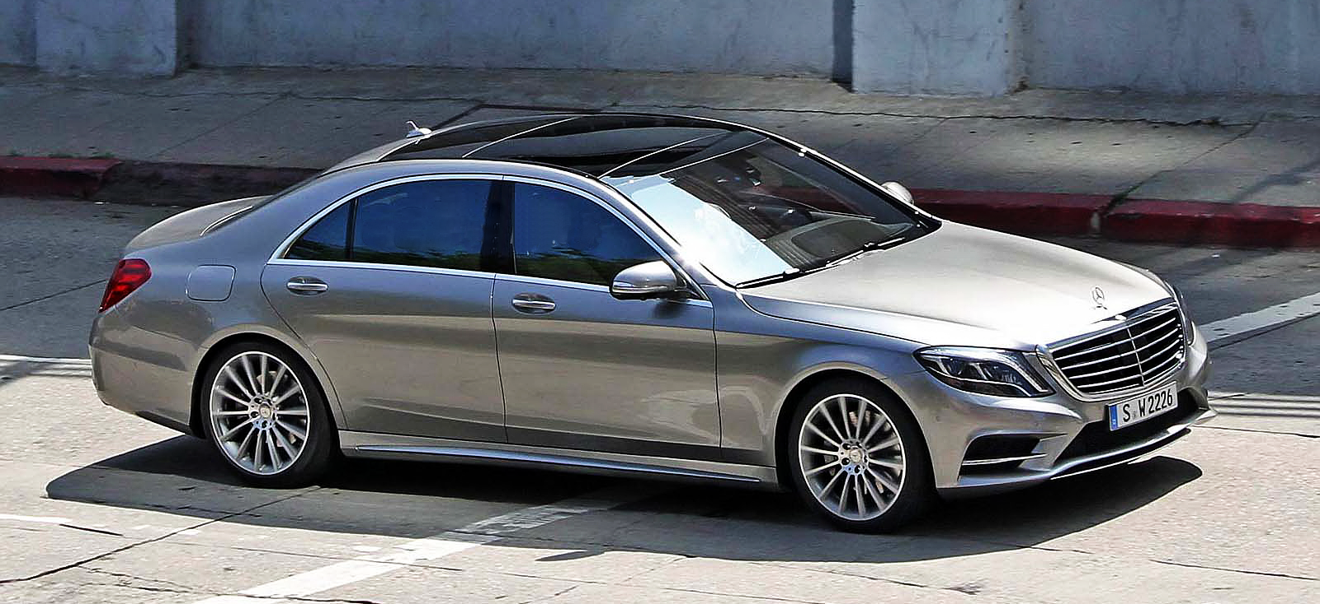
Thailand Business Day
7 June 2013 – Asia Pacific Weeks, Berlin

Slide 2

Profile Daimler Group Thailand - Legal Structure
Daimler AG
100%
Mercedes-Benz (Thailand) Ltd. (MBTh)
100%
100%
Mercedes-Benz Manufacturing (Thailand) Ltd. (MBMTh)
Mercedes-Benz Leasing (Thailand) Ltd.
(MBLT)

Slide 3

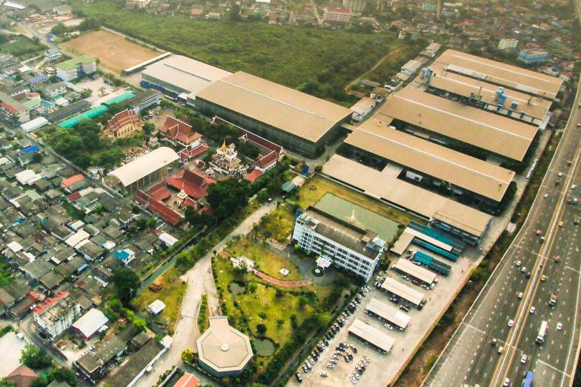
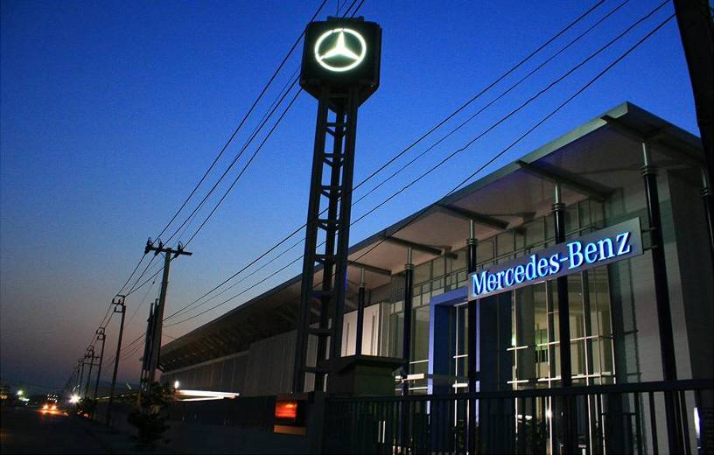
Profile Daimler Group Thailand - Locations
TAAP
Thonburi Automotive Assembly Plant CKD Plant in Samutprakarn Thailand
MBCC
Mercedes-Benz Competence Center
19th km on Bangna-Trad Rd.
Bangkok
Head office
Rajanakarn Building, 19th floor
South Sathorn Rd. Bangkok

Slide 4
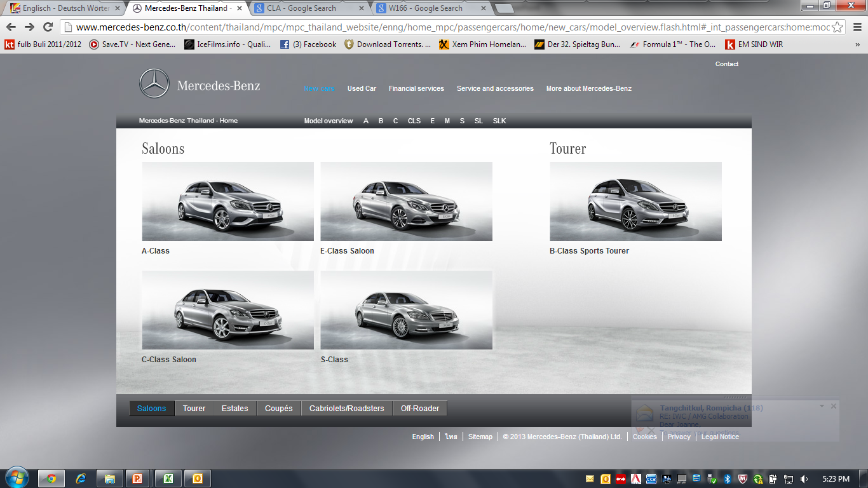
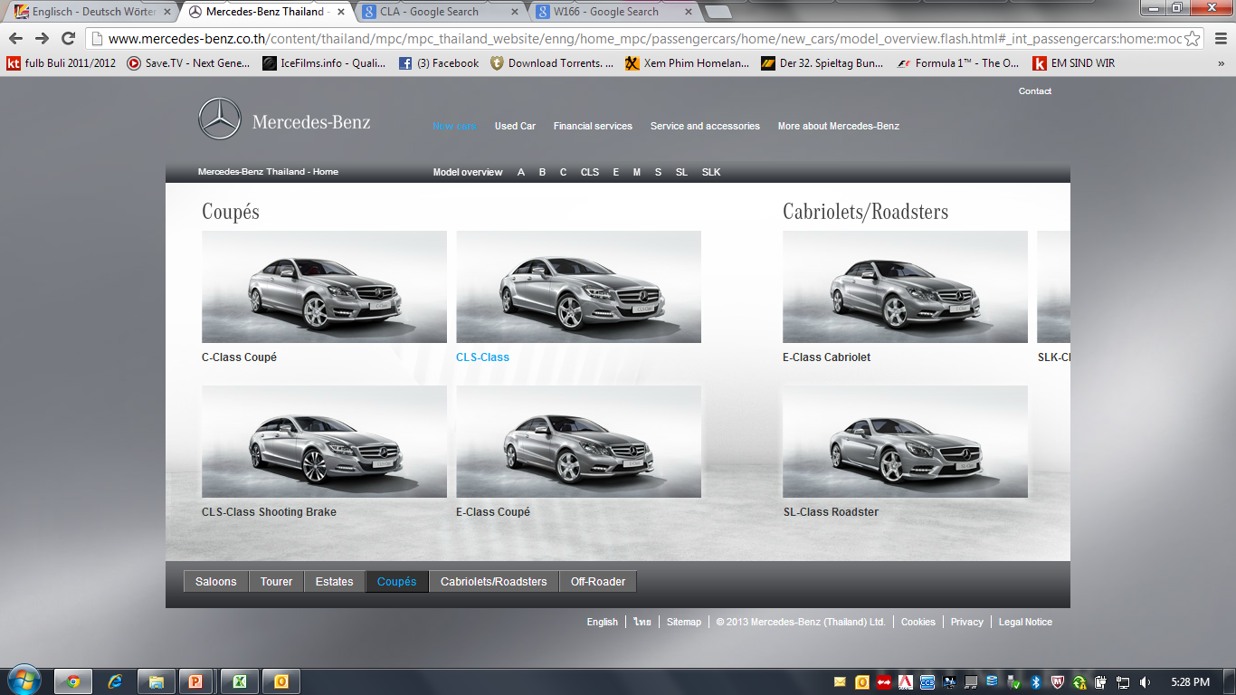
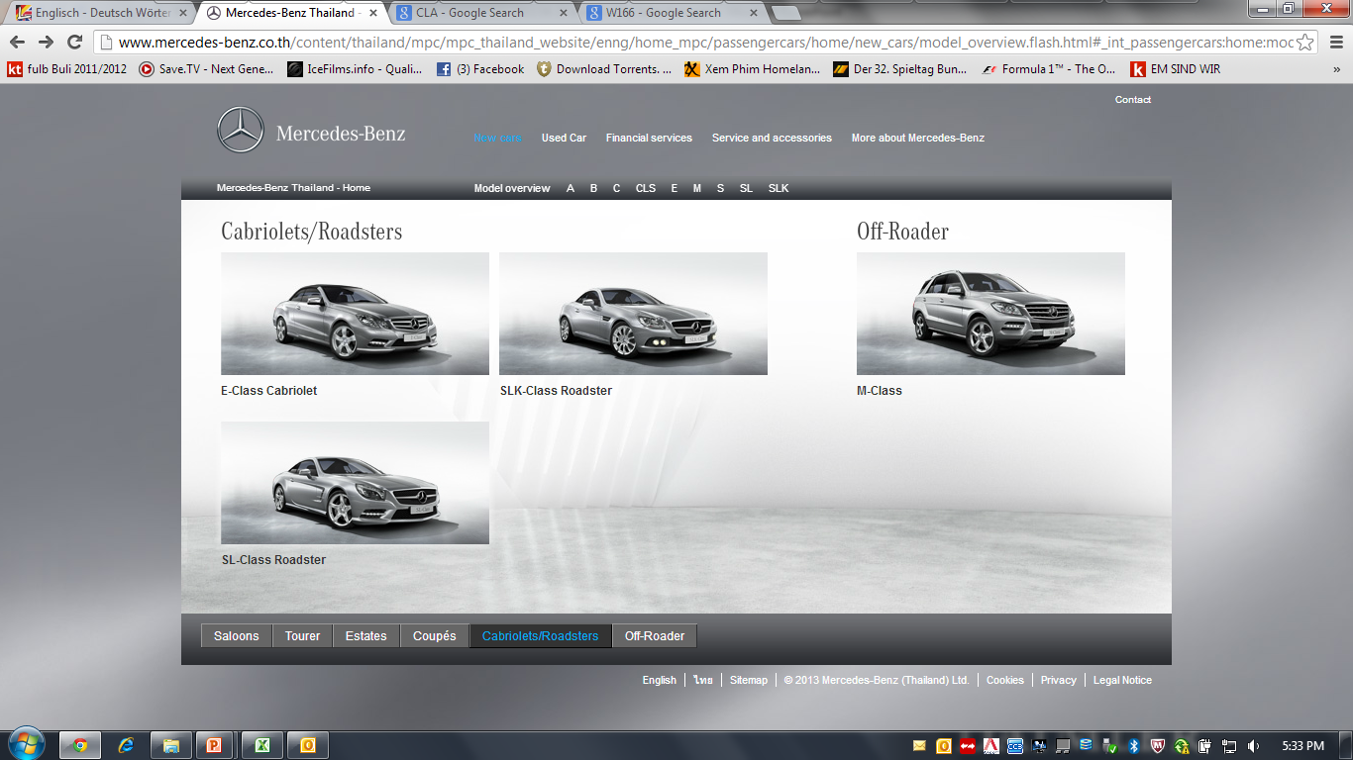
Profile Daimler Group Thailand - Products
Local Production (CKD)
Import Completely Built Up (CBU)
Notes:
Presentation title in CorpoS Regular 9 pt | Department | Date
4

Slide 5
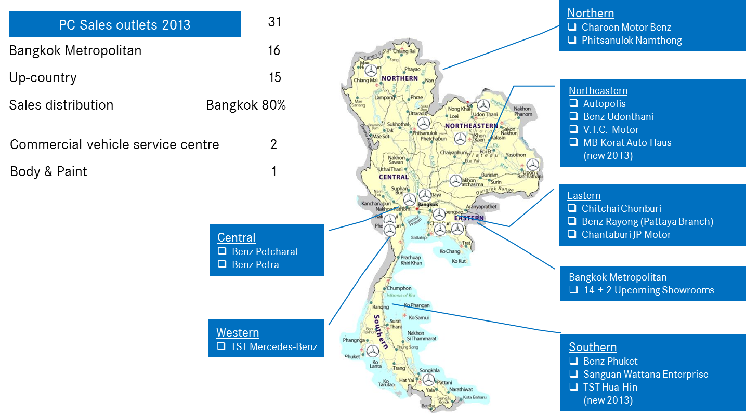
Profile Daimler Group Thailand – Dealer Network

Slide 6
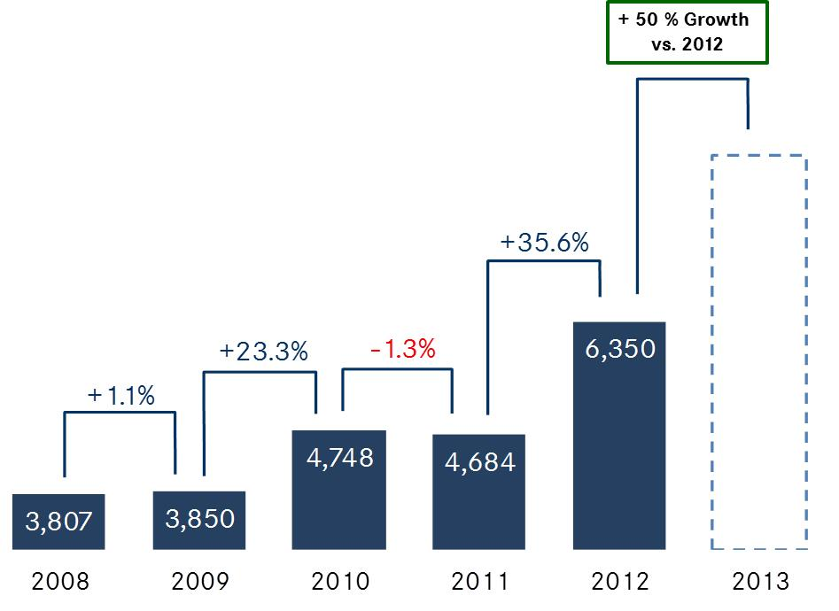
Sales Situation - Retail sales MB Thailand
MB Thailand with very promising outlook for 2013: >50% growths
Product Offensive with compact cars
and new SKD models (M-Class)
Fast start in the year with +41% YTD April
Record Order intake at Bangkok
International Motor Show

Slide 7
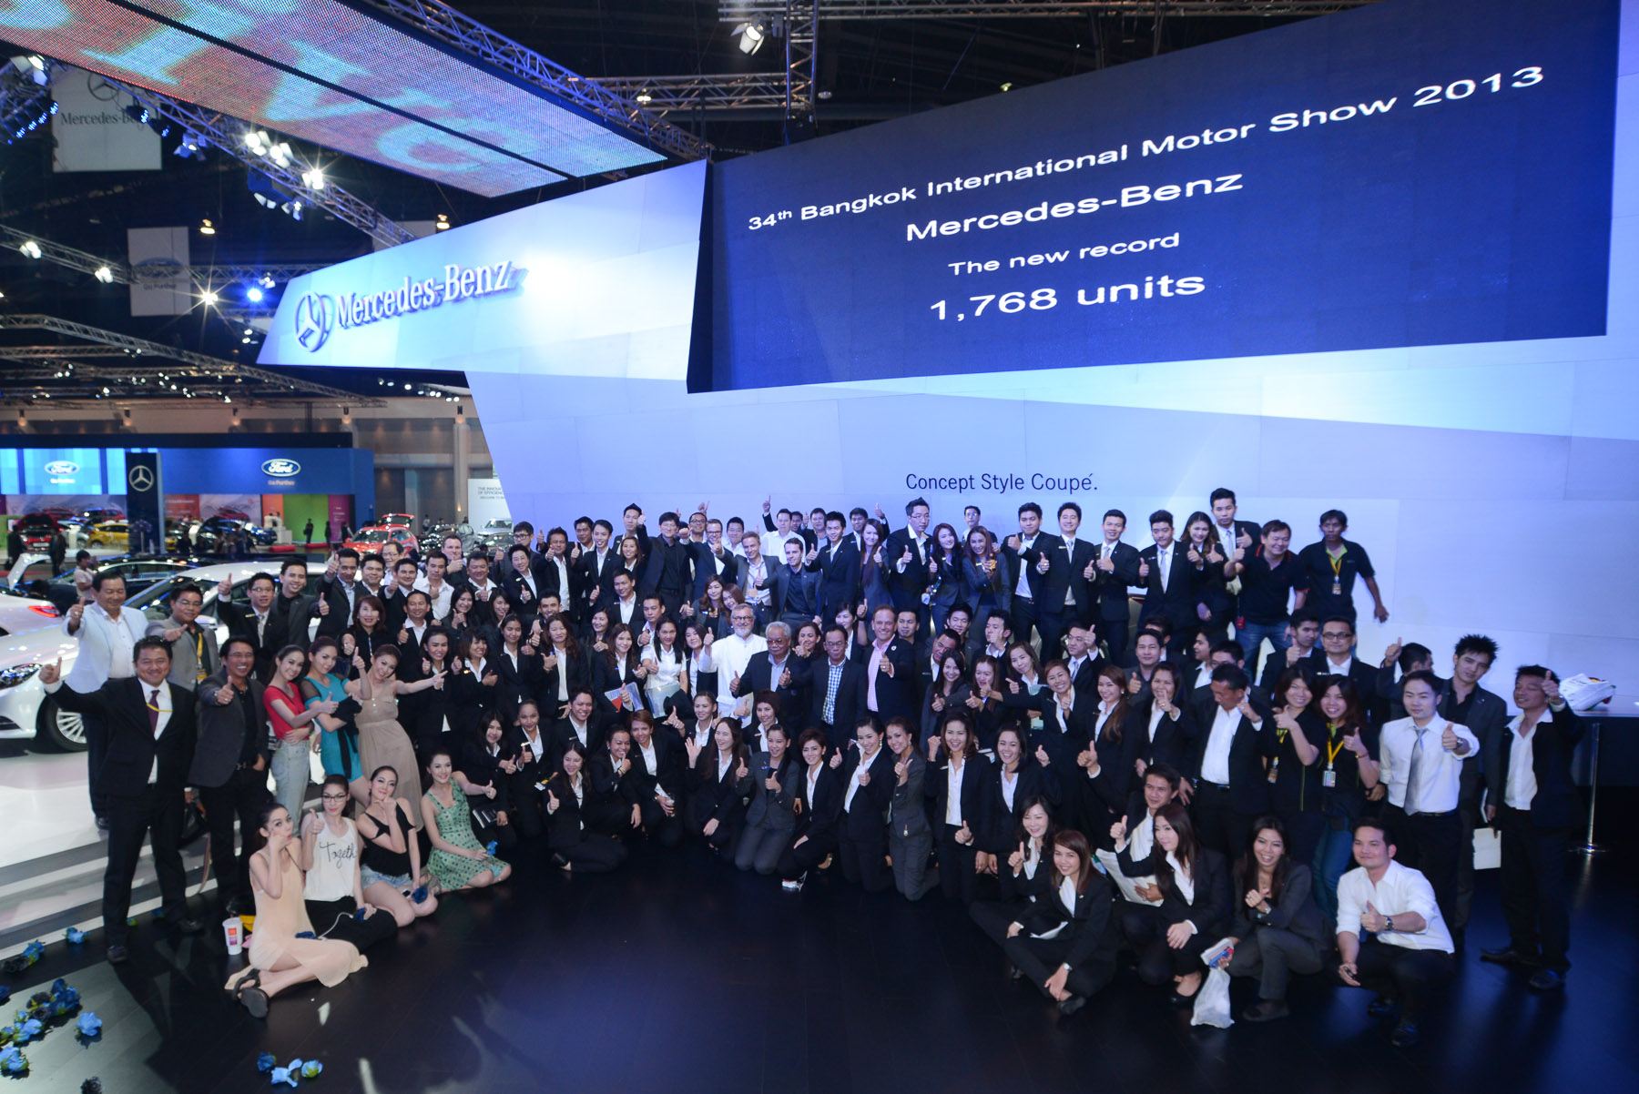
Sales Situation – Bangkok Motor Show 2013
During Bangkok International Motor Show highest order intake during a motor show was recorded – against market trend
Brand | Orders EXPO 12 | Orders BIMS 13 | Diff
Toyota | 18,878 | 10,341 | -45%
Honda | 19,299 | 7,788 | -60%
Ford | 5,689 | 1,880 | -67%
Chevrolet | 3,215 | 1,953 | -39%
BMW | 1,299 | N/A | -
MB | 1,580 | 1,776 | 12%
Type Class | Orders
A-Class | 210
C-Class | 307
C-Coupe | 71
SLK | 103
E-Class FL | 698
CLS (incl SB) | 87
M-Class | 107
S-Class | 41
TOTAL | 1,776

Slide 8

Sales Situation – Grey Market
Grey market significantly developed as from
2010 and even exceeding official MB sales in 2012
Grey network has well established by end of 2012
with more than 200 outlets
Numerous countermeasures taken by
Daimler in 2012
Fruitful dialogue with Thai authorities and
Anti Corruption Commission until end of 2012.
Thus, grey market still present in 2013.
Currently >2.000 grey vehicles at customs
to be released by June.
Further Support by local authorities needed in order to fight tax fraud of grey market

Slide 9
Strategic Outlook – Key Drivers
Thailand with significant strategic growths potential for Mercedes Benz Passenger Cars
especially over the next 2 years
Main growth drivers are…
Extend leadership in green technologies (Hybridization)
Product offensive in compact car segment
Re-conquer market share from grey
Expand MB dealer network
9

Slide 10
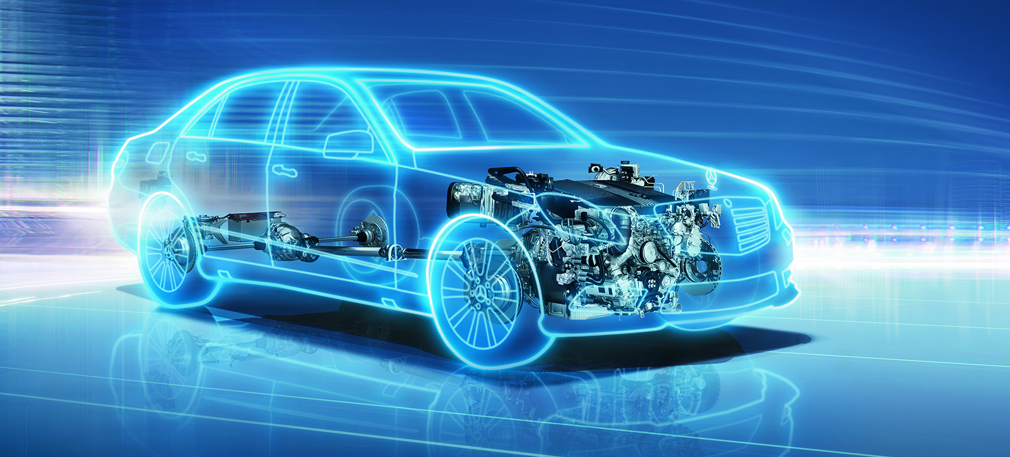
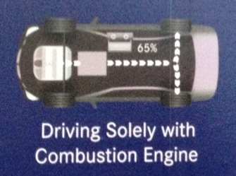
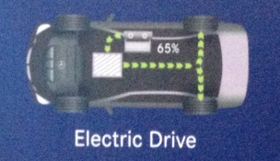
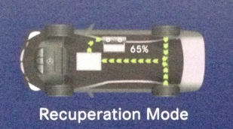
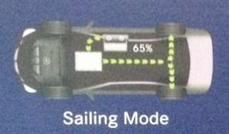

Strategic Outlook – Green Technologies until 2015
New Technologies – First Diesel Hybrid in the World (E-Class) to be launched in July 13
Defend Leadership in green Technologies and comply with local tax system
Hybridization for entire CKD product range ( S-Class, C-Class, M-Class )
10
Notes:
Presentation title in CorpoS Regular 9 pt | Department | Date
10

